Slide 1

Sustainability and Environmental Impact
The CRM System Implementation aims to enhance customer relations sustainably, aligning with our company's values.
by aya chkioua

Slide 2
Introduction
Project Overview
Alignment with Values
The project focuses on enhancing customer relations sustainably while minimizing environmental impact.
Commitment to sustainability reflects the integration of environmental responsibility into our corporate strategy.

Slide 3
Importance of Sustainability
1
Corporate Responsibility
2
Brand Image
Sustainability is integral to our corporate responsibility, emphasizing long-term success and positive brand image.
Reducing our environmental footprint contributes to a positive brand image and public perception.

Slide 4

Considerations for Sustainability
Energy Efficiency
Resource Optimization
Selecting energy-efficient servers and hardware to reduce energy consumption.
Minimizing resource usage by leveraging cloud-based solutions to decrease environmental impact.
Lifelong Productivity
Choosing products with a longer lifespan to reduce electronic waste and promote sustainability.

Slide 5
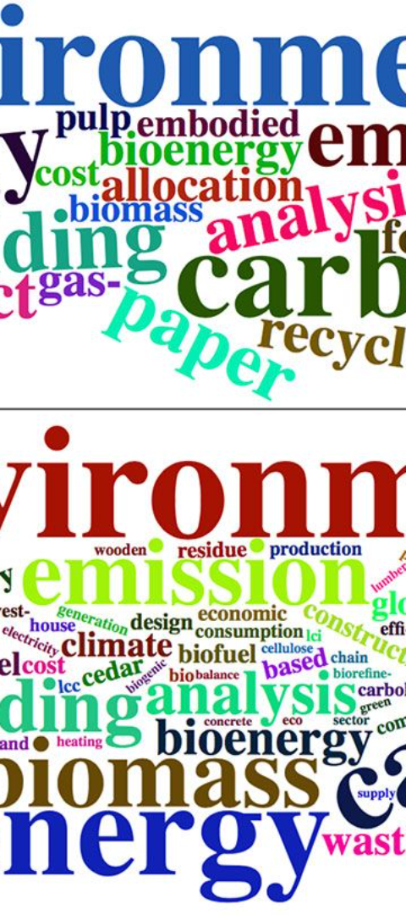
Environmental Impact Assessment
1
Comprehensive Assessment
A comprehensive environmental impact assessment considered energy consumption, waste generation, and potential emissions.
2
Areas for Improvement
Identified areas for improvement and sustainable practices to reduce our ecological footprint.

Slide 6



Impact on Energy Consumption
Server Optimization
Optimization of server configurations to reduce energy consumption and promote sustainability.
Energy-Saving Features
Implementation of energy-saving features during periods of low system usage to minimize environmental impact.

Slide 7
Waste Reduction Strategies
Recycling Program
Electronic Documentation
Adoption of a recycling program for old hardware components to reduce waste and encourage sustainability.
Encouragement of electronic documentation to reduce paper waste and promote environmental responsibility.

Slide 8

Eco-Friendly Practices Implemented
1
Paperless Documentation
2
Remote Collaboration
Transitioned to electronic documentation to reduce paper usage and environmental impact.
Encouraged virtual meetings to decrease travel-related emissions and enhance sustainability.

Slide 9
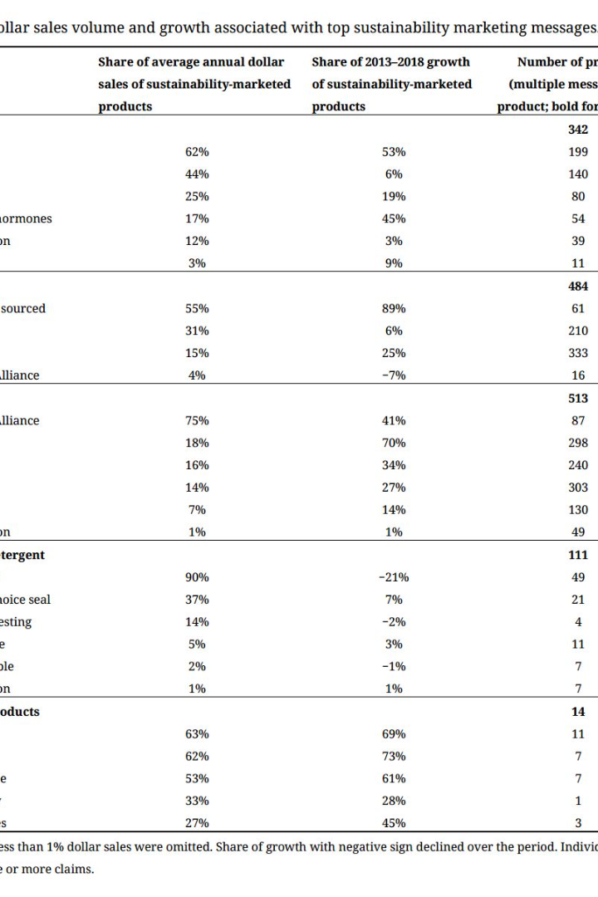
Sustainable Procurement
Procurement Guidelines
Prioritized suppliers with eco-friendly practices and sustainable product offerings.
Integrated environmentally friendly materials in the procurement process.

Slide 10



Continuous Improvement and Future Commitments
Regular monitoring of environmental impact and continuous refinement of sustainability practices. Commitment to setting future goals for further reducing our ecological footprint.

